Slide 1
Unit -3
NodeJs
Advanced Web Technology
Dept. of Computer Engineering

Slide 2
Content
Setup Node JS Environment,
Package Manager,
Features,
Console
Object,
Concept of Callbacks,
Work with File System,
Debugging,

Slide 3
Syllabus
Events and Event Loop,
timers, Buffers,
Streams,
Express.js
framework,
Mongoose module,
Database Connectivity,
Node JS
REST API, Sessions and Cookie

Slide 4
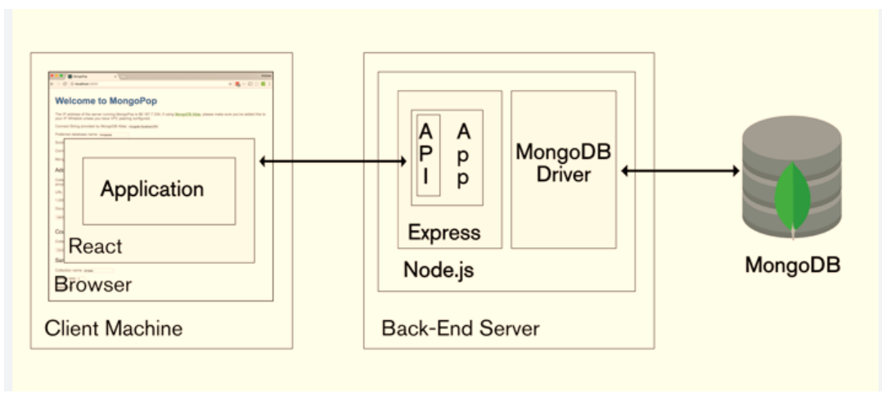
NodeJs
What is NodeJs?

Slide 5
What is NodeJs
Node.js is a runtime environment that executes JavaScript code outside a browser. It is an open-source, asynchronous, back-end, and cross-platform compatible runtime environment.
It is designed to build scalable apps and allows developers to use JavaScript for server-side scripting.
With Node.js, backend development has been changed significantly as Node.js enables the use of a single programming language to build complete websites.

Slide 6
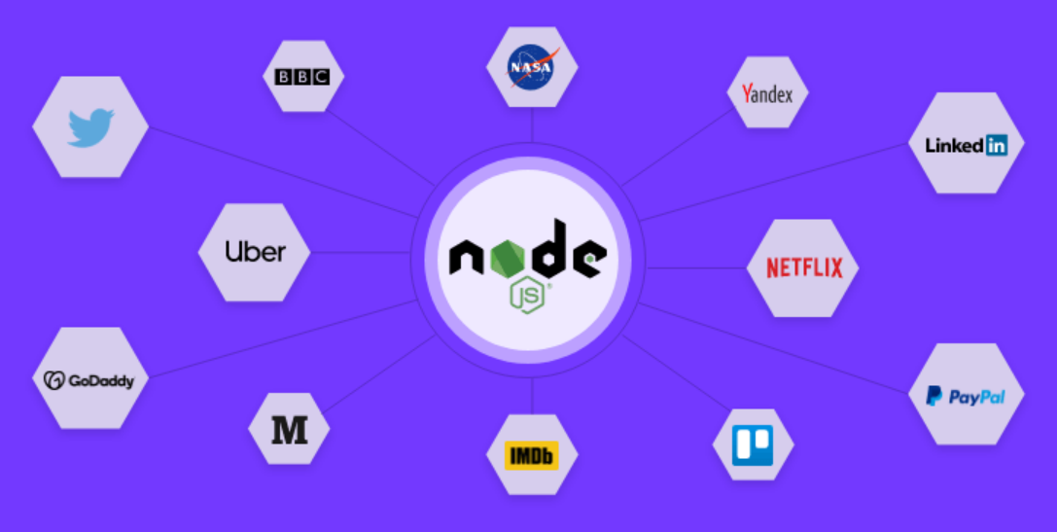
Companies that uses NodeJS

Slide 7
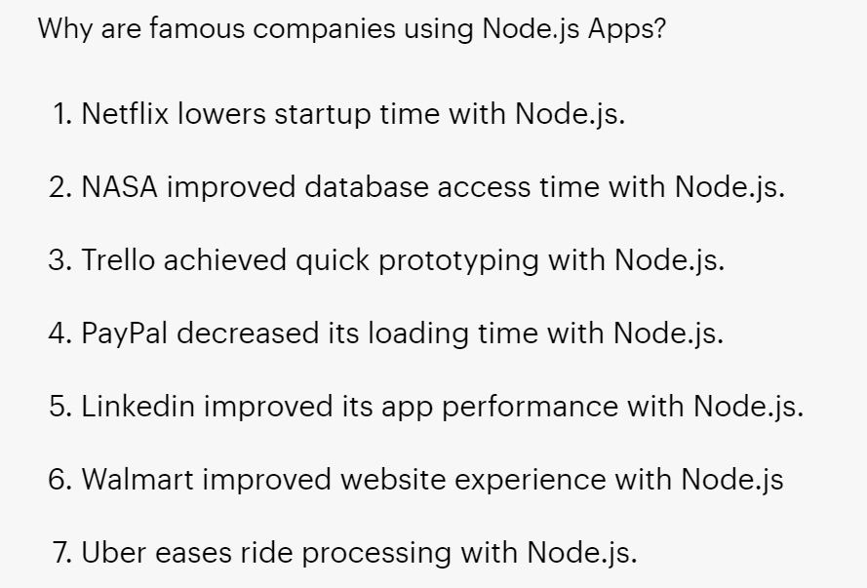
Why are companies using NodeJs ?

Slide 8
Environmental Setup
Install Node.js:
Go to the official Node.js website (https://nodejs.org) and download the latest LTS (Long-Term Support) version for your operating system. LTS versions are more stable and recommended for most projects.
Install npm (Node Package Manager):
npm comes bundled with Node.js, so after installing Node.js, you'll have npm automatically.
Choose a Code Editor:
Select a code editor that suits your preferences. Some popular choices are Visual Studio Code, Atom, Sublime Text, or WebStorm.

Slide 9
Environmental Setup
Create a Project Directory:
Create a new folder on your computer to hold your Node.js project.
Initialize Your Project:
Open your terminal or command prompt, navigate to the project directory you just created, and run the following command to initialize a new Node.js project. This will generate a package.json file that will manage your project's dependencies.
npm init

Slide 10
Environmental Setup
Install Required Packages:
Use npm to install any Node.js packages or libraries that your project needs. For example, to install Express, one of the most popular web frameworks for Node.js, run the following
npm install express
Create Your Node.js Application:
Create your Node.js application code using your preferred code editor. For example, if you're using Express, you might create an app.js file and set up your server there.

Slide 11
Environmental Setup
Run Your Node.js Application:
Once you've written your Node.js code, save the file, and in your terminal, navigate to your project directory. Then, run your Node.js application using the following command:
node app.js
Verify Your Setup:
Open a web browser and visit http://localhost:3000 (assuming you are using Express on port 3000, but it might be different depending on your application setup). If everything is set up correctly, you should see your Node.js application running.
For adding more packages :
npm install <package name>

Slide 12
Example:-
const express = require('express');
const app = express();
const port = 3000; // You can choose any port you prefer
app.get('/', (req, res) => {
res.send('Hello, Express!');
});
app.listen(port, () => {
console.log(`Server is listening on port ${port}`);
});

Slide 13
Package Manager
NPM (Node Package Manager) is the default package manager for Node.js and is written entirely in Javascript. Developed by Isaac Z. Schlueter, it was initially released in January 12, 2010. NPM manages all the packages and modules for Node.js and consists of command line client npm. It gets installed into the system with installation of Node.js. The required packages and modules in Node project are installed using NPM.

Slide 14
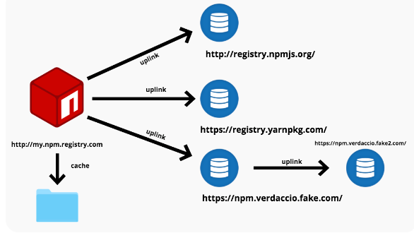
NPM(node package manager)

Slide 15
Package Manager
A package contains all the files needed for a module and modules are the JavaScript libraries that can be included in Node project according to the requirement of the project.
NPM can install all the dependencies of a project through the package.json file. It can also update and uninstall packages.
Installing NPM: To install NPM, it is required to install Node.js as NPM gets installed with Node.js automatically. Install Node.js.

Slide 16
Features
Functions of Node.js
Following are some of the functions that can be performed by Node.js –
Collects data from forms.
Data in the database is added, deleted, and changed.
Renders dynamic content for web pages.
Files on the server are created, read, written, deleted, and closed.

Slide 17
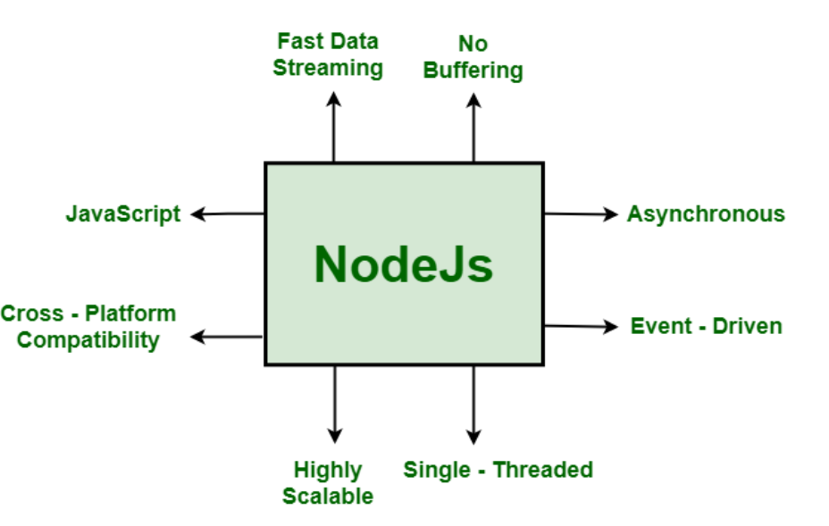
Features of NodeJs

Slide 18
Features
Asynchronous and Event-Driven: The Node.js library’s APIs are all asynchronous (non-blocking) in nature. A server built with Node.JS never waits for data from an API. After accessing an API, the server moves on to the next one. In order to receive and track responses of previous API requests, it uses a notification mechanism called Events.
Single-Threaded: Node.js employs a single-threaded architecture with event looping, making it very scalable. In contrast to typical servers, which create limited threads to process requests, the event mechanism allows the node.js server to reply in a non-blocking manner and makes it more scalable. When compared to traditional servers like Apache HTTP Server, Node.js uses a single-threaded program that can handle a considerably larger number of requests.

Slide 19
Features
Scalable: NodeJs addresses one of the most pressing concerns in software development: scalability. Nowadays, most organizations demand scalable software. NodeJs can also handle concurrent requests efficiently. It has a cluster module that manages load balancing for all CPU cores that are active. The capability of NodeJs to partition applications horizontally is its most appealing feature. It achieves this through the use of child processes. This allows the organizations to provide distinct app versions to different target audiences, allowing them to cater to client preferences for customization.
Quick execution of code: Node.js makes use of the V8 JavaScript Runtime motor, which is also used by Google Chrome. Hub provides a wrapper for the JavaScript motor, which makes the runtime motor faster. As a result, the preparation of requests inside Node.js becomes faster as well.

Slide 20
Features
Cross-platform compatibility: NodeJS may be used on a variety of systems, including Windows, Unix, Linux, Mac OS X, and mobile devices. It can be paired with the appropriate package to generate a self-sufficient executable.
Uses JavaScript: JavaScript is used by the Node.js library, which is another important aspect of Node.js from the engineer’s perspective. Most of the engineers are already familiar with JavaScript. As a result, a designer who is familiar with JavaScript will find that working with Node.js is much easier.

Slide 21
Features
Fast data streaming: When data is transmitted in multiple streams, processing them takes a long time. Node.js processes data at a very fast rate. It processes and uploads a file simultaneously, thereby saving a lot of time. As a result, NodeJs improves the overall speed of data and video streaming.
No Buffering: In a Node.js application, data is never buffered.

Slide 22
Disadvantages of NodeJs
Disadvantages of Node.js
API is not stable and keeps changing for NodeJs.
Code for large applications is complex due to the asynchronous nature of NodeJs.
Does not have a strong library support system

Slide 23
Applications of Node.js
The following are some of the areas where Node.js is proving to be an effective technology partner-
Single Page Applications
Data-Intensive Real-time Applications
I/O bound Applications
JSON APIs based Applications
Data Streaming Applications

Slide 24
Object Console
Node.js console is a global object and is used to print different levels of messages to stdout and stderr. There are built-in methods to be used for printing informational, warning, and error messages.
1. console.log([data][, ...])
Prints to stdout with newline. This function can take multiple arguments in a printf()-like way.
2. console.info([data][, ...])
Prints to stdout with newline. This function can take multiple arguments in a printf()-like way.

Slide 25
3. console.error([data][, ...])
Prints to stderr with newline. This function can take multiple arguments in a printf()-like way.
4. console.warn([data][, ...])
Prints to stderr with newline. This function can take multiple arguments in a printf()-like way
5. console.dir(obj[, options])
Uses util.inspect on obj and prints resulting string to stdout.

Slide 26
6. console.time(label)
Mark a time.
7. console.timeEnd(label)
Finish timer, record output.
8. console.trace(message[, ...])
Print to stderr 'Trace :', followed by the formatted message and stack trace to the current position.
9. console.assert(value[, message][, ...])
Similar to assert.ok(), but the error message is formatted as util.format(message...).

Slide 27
Concept of Callbacks
Node.js callbacks are a special type of function passed as an argument to another function.
They're called when the function that contains the callback as an argument completes its execution, and allows the code in the callback to run in the meantime.
Callbacks help us make asynchronous calls.

Slide 28
Example :-
function sum(a,b){
return a+b
}
function show(holder, myCallback){
console.log('strings passed>>', holder)
return myCallback(1,2)
}
let something = 'hi nice to meet u!'
console.log(show(something,sum))

Slide 29
Work with File System
To handle file operations like creating, reading, deleting, etc., Node.js provides an inbuilt module called FS (File System). Node.js gives the functionality of file I/O by providing wrappers around the standard POSIX functions. All file system operations can have synchronous and asynchronous forms depending upon user requirements.
To use this File System module, use the require() method:
var fs = require('fs');

Slide 30
Common use for File System module:
Read Files
Write Files
Append Files
Close Files
Delete Files

Slide 31
The fs.readFile() method is used to read files on your computer.
var http = require('http');
var fs = require('fs');
http.createServer(function (req, res) {
fs.readFile('demofile1.html', function(err, data) {
res.writeHead(200, {'Content-Type': 'text/html'});
res.write(data);
return res.end();
});
}).listen(8080);

Slide 32
Write File
The fs.writeFile() method replaces the specified file and content if it exists. If the file does not exist, a new file, containing the specified content, will be created:
var fs = require('fs');
fs.writeFile('mynewfile3.txt', 'Hello content!', function (err) {
if (err) throw err;
console.log('Saved!');
});

Slide 33
Append File
The fs.appendFile() method appends specified content to a file. If the file does not exist, the file will be created:
var fs = require('fs');
fs.appendFile('mynewfile1.txt', 'Hello content!', function (err) {
if (err) throw err;
console.log('Saved!');
});

Slide 34
Open File
The fs.open() method takes a "flag" as the second argument, if the flag is "w" for "writing", the specified file is opened for writing. If the file does not exist, an empty file is created:
var fs = require('fs');
fs.open('mynewfile2.txt', 'w', function (err, file) {
if (err) throw err;
console.log('Saved!');
});

Slide 35
Update File
The fs.appendFile() method appends the specified content at the end of the specified file:
var fs = require('fs');
fs.appendFile('mynewfile1.txt', ' This is my text.', function (err) {
if (err) throw err;
console.log('Updated!');
});

Slide 36
Update File
The fs.writeFile() method replaces the specified file and content:
var fs = require('fs');
fs.writeFile('mynewfile3.txt', 'This is my text', function (err) {
if (err) throw err;
console.log('Replaced!');
});

Slide 37
Delete File
The fs.unlink() method deletes the specified file:
var fs = require('fs');
fs.unlink('mynewfile2.txt', function (err) {
if (err) throw err;
console.log('File deleted!');
});

Slide 38
The fs.rename() method renames the specified file:
var fs = require('fs');
fs.rename('mynewfile1.txt', 'myrenamedfile.txt', function (err) {
if (err) throw err;
console.log('File Renamed!');
});

Slide 39
Debugging
Debugging in Node.js refers to the process of identifying and fixing issues, errors, and unexpected behaviors in your Node.js applications. It involves inspecting and analyzing the code execution, variable values, and program flow to understand why the application is not functioning as expected.
Common reasons for debugging in Node.js include:
Identifying and fixing syntax errors: Syntax errors prevent the code from running correctly, and debugging helps to locate and resolve these issues.

Slide 40
Debugging
Finding logical errors: Logical errors are bugs in the code that lead to incorrect results or undesired behavior. Debugging helps pinpoint the cause of such errors and allows developers to make corrections.
Understanding runtime behavior: Debugging provides insights into how the code behaves during runtime, which helps in understanding complex control flows and the sequence of function calls.
Investigating exceptions and crashes: When an unhandled exception occurs or the application crashes, debugging can help identify the root cause and fix the issue.

Slide 41
Debugging
Inspecting variable values: During debugging, you can inspect the values of variables at different points in the code, helping you understand why certain conditions are met or not met.
Stepping through the code: Debugging allows developers to execute the code line-by-line or step-by-step, making it easier to understand the flow of execution and identify where issues occur.

Slide 42
Debugging
Node.js provides several tools and techniques for debugging, including:
Console.log() statements: Simple console.log() statements can be used to print values to the console and observe the flow of execution.
Node.js Inspector: The Node.js Inspector allows you to debug Node.js applications using Chrome Developer Tools. It enables you to set breakpoints, inspect variables, and step through code.
Visual Studio Code (VS Code) Debugger: VS Code offers built-in support for Node.js debugging, providing a user-friendly interface to set breakpoints, inspect variables, and control the execution flow.

Slide 43
Debugging
Command-line debugging: Node.js supports debugging using the --inspect flag, allowing developers to connect a debugger like Chrome DevTools or Visual Studio Code to the application.
Third-party debugging tools: There are also third-party tools like NDB that provide an improved debugging experience with additional features.
Overall, debugging is a crucial skill for developers to identify and fix issues in Node.js applications, ensuring they work as intended and deliver a smooth user experience.

Slide 44
Events
Events in Node.js are a mechanism for handling and responding to asynchronous actions or signals. They allow different parts of the code to communicate and react to specific occurrences, such as a file being read, an HTTP request arriving, or a timer expiring. Node.js implements events using the EventEmitter class, which is a core module that provides an event-driven programming interface.
The EventEmitter class allows objects to emit named events and register listeners (callback functions) to handle those events. When an event is emitted, all registered listeners for that event are invoked in the order they were registered.

Slide 45
Events
const EventEmitter = require('events');
// Create a new EventEmitter instance
const myEmitter = new EventEmitter();
// Register a listener for the 'greet' event
myEmitter.on('greet', (name) => {
console.log(`Hello, ${name}!`);
});
// Emit the 'greet' event
myEmitter.emit('greet', 'John');

Slide 46
Event loop
The event loop is the heart of Node.js, responsible for handling all I/O operations and managing asynchronous events. It allows Node.js to execute non-blocking code efficiently, enabling it to handle multiple operations concurrently without getting blocked.
The event loop continually checks for pending events, such as I/O operations or timers, in a loop. When a pending event is detected, the associated callback function is added to the queue for execution. The event loop processes the callback queue in a single-threaded manner, executing the callbacks one by one in a non-blocking fashion.

Slide 47
Event loop
By using the event loop, Node.js can offload I/O operations to the underlying operating system and efficiently manage concurrent operations without the need for creating additional threads or processes for each request.
In summary, events and the event loop are fundamental concepts in Node.js that enable asynchronous, non-blocking I/O operations. Events, managed by the EventEmitter class, allow code to communicate and react to specific occurrences, while the event loop ensures that non-blocking operations are efficiently executed in a single-threaded manner, allowing Node.js to handle multiple concurrent requests effectively.

Slide 48
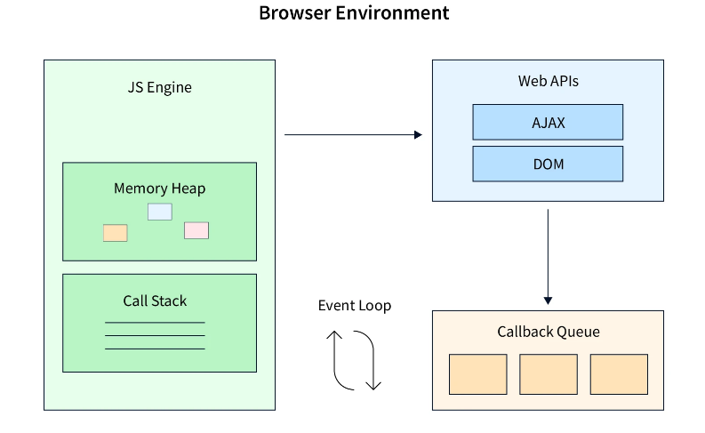
Event loop

Slide 49
Timers
In Node.js, timers are a set of functions and classes that allow you to schedule the execution of code at a specified time or after a certain delay. Timers are useful for implementing time-based operations, such as running periodic tasks, delaying the execution of a function, or setting timeouts.
Node.js provides three types of timers:
setTimeout():
The setTimeout() function allows you to schedule the execution of a callback function after a specified delay (in milliseconds). It returns a timer object that can be used to cancel the scheduled task using clearTimeout().

Slide 50
clearTimeout():
The clearTimeout() function is used to cancel a previously scheduled timeout created by setTimeout() before it gets executed.
const delay = 2000; // 2 seconds
const timer = setTimeout(() => {
console.log('This will be canceled and not executed.');
}, delay);
// Cancel the scheduled timeout
clearTimeout(timer);

Slide 51
setInterval():
The setInterval() function is used to schedule the execution of a callback function repeatedly at a fixed interval. It returns a timer object that can be used to stop the repeated execution using clearInterval().
const interval = 1000; // 1 second
const timer = setInterval(() => {
console.log('This will be executed every 1 second.');
}, interval);

Slide 52
clearInterval():
The clearInterval() function is used to stop the execution of a callback function scheduled with setInterval().
clearInterval(timer);

Slide 53
setImmediate() will execute code at the end of the current event loop cycle. This code will execute after any I/O operations in the current event loop and before any timers scheduled for the next event loop.
console.log('before immediate');
setImmediate((arg) => {
console.log(`executing immediate: ${arg}`);
}, 'so immediate');
console.log('after immediate');

Slide 54
clearImmediate():
This allows you to prevent the callback from being executed if it hasn't already run.
It's essential to note that clearImmediate() requires the immediate ID as its argument. The immediate ID is returned when you call setImmediate().
clearImmediate(immediateId);

Slide 55
Buffers
Buffer refers to the particular memory location in memory. Buffer and array have some similarities, but the difference is array can be any type, and it can be resizable. Buffers only deal with binary data, and it can not be resizable. Each integer in a buffer represents a byte.
Buffers are useful when dealing with file systems, network communications, cryptography, and other situations where you need to handle binary data efficiently.

Slide 56
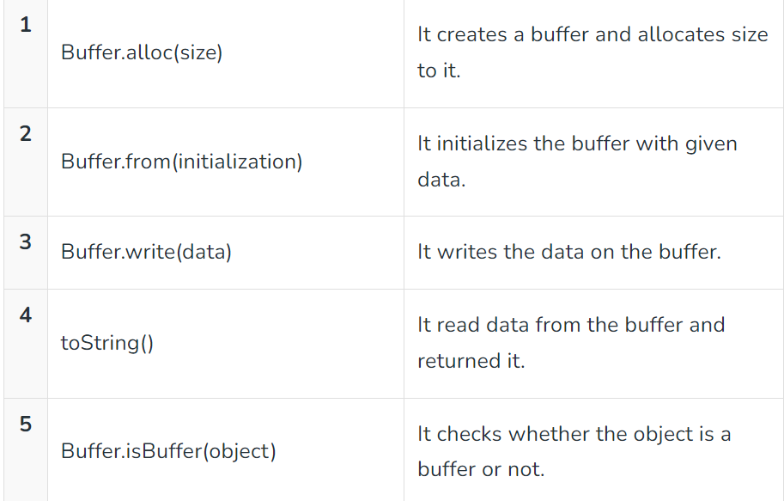
Buffers

Slide 57
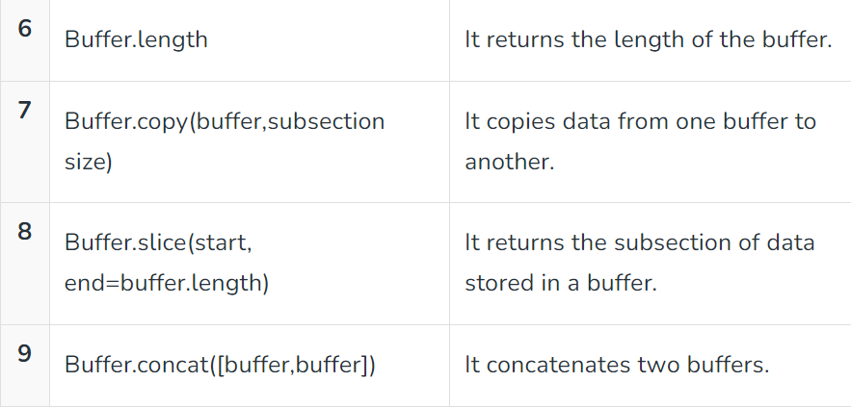

Slide 58
Example
// Step 1: Import the 'buffer' module
const { Buffer } = require('buffer');
// Step 2: Create a buffer with some data
const data = 'Hello, this is a buffer example!';
const buffer = Buffer.from(data, 'utf8');
// Step 3: Print the buffer
console.log(buffer);
// Step 4: Convert the buffer back to a string
const convertedData = buffer.toString('utf8');
console.log(convertedData);

Slide 59
Streams
Streams are a type of data-handling methods and are used to read or write input into output sequentially. Streams are used to handle reading/writing files or exchanging information in an efficient way.
There are four types of streams in Node.js:
Readable Streams: These streams are used for reading data. Examples include reading data from a file, receiving data from an HTTP request, or reading data from a database query result. Readable streams emit a 'data' event whenever a new chunk of data is available, and a 'end' event when all data has been consumed.

Slide 60
Writable Streams: These streams are used for writing data. Examples include writing data to a file, sending data over an HTTP response, or writing data to a database. Writable streams have a write() method to which you can pass data, and they emit a 'finish' event when all data has been written.
Duplex Streams: These streams are both readable and writable. Duplex streams allow bidirectional communication, where data can be both read and written simultaneously.
Transform Streams: These streams are a type of duplex stream that allows data manipulation while reading or writing. Transform streams take input data, process it, and produce modified data as output. They are useful for tasks like compression, encryption, or data parsing.

Slide 61
const fs = require('fs');
// Readable stream (reading from file)
const readableStream = fs.createReadStream('input.txt', 'utf8');
readableStream.on('data', (chunk) => {
console.log('Received chunk:');
console.log(chunk);
});
readableStream.on('end', () => {
console.log('Read operation complete.');
});
// Writable stream (writing to file)
const writableStream = fs.createWriteStream('output.txt', 'utf8');
writableStream.write('Hello, this is written using a writable stream!\n');
writableStream.write('This is another line.\n');
writableStream.end(() => {
console.log('Write operation complete.');
});

Slide 62
ExpressJs
Express.js is a small framework that works on top of Node.js web server functionality to simplify its APIs and add helpful new features. It makes it easier to organize your application’s functionality with middleware and routing. It adds helpful utilities to Node.js HTTP objects and facilitates the rendering of dynamic HTTP objects.

Slide 63
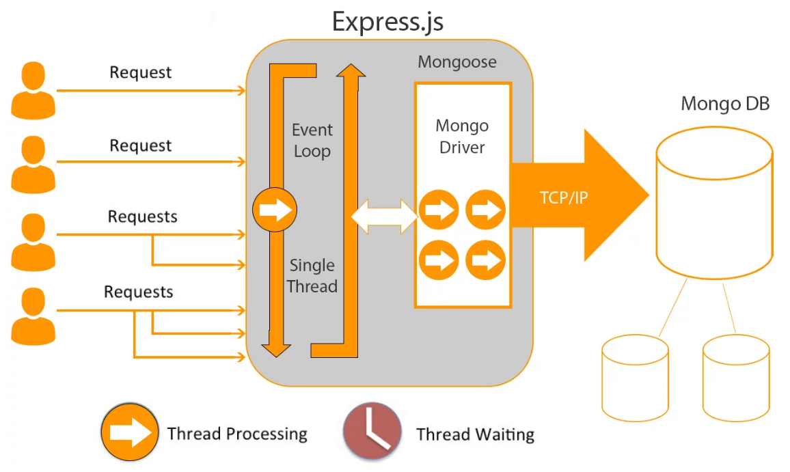
ExpressJs

Slide 64
Why Express ?
Develops Node.js web applications quickly and easily.
It’s simple to set up and personalise.
Allows you to define application routes using HTTP methods and URLs.
Includes a number of middleware modules that can be used to execute additional requests and responses activities.
Simple to interface with a variety of template engines, including Jade, Vash, and EJS.
Allows you to specify a middleware for handling errors.

Slide 65
Install ExpressJs and example code
npm init
npm i express
var express = require('express');
var app = express();
app.get('/', function (req, res) {
res.send("Welocme to GeeksforGeeks!");
});
app.listen(5000);

Slide 66
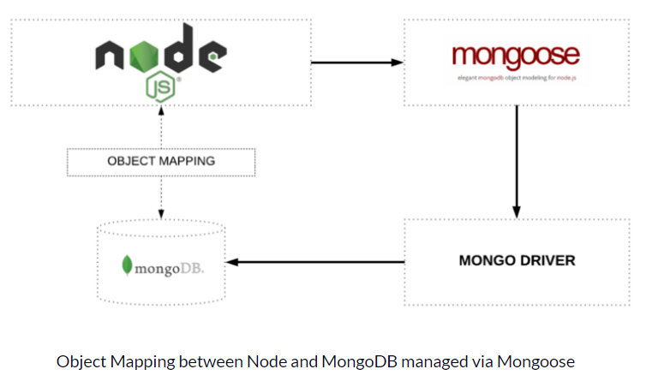
Mongoose Module
Mongoose module is one of the most powerful external modules of NodeJS. Mongoose is a MongoDB ODM i.e (Object database Modelling) that used to translate the code and its representation from MongoDB to the Node.js server.

Slide 67
Advantages of Mongoose module:
Collection validation of the MongoDB database can be done easily.
Predefined Structure can be implemented on the collection.
Constraints can be applied to documents of collections using Mongoose.
Mongoose module built on the top of MongoDB driver and provides easily abstraction of the query and define a query.
Mongoose can be installed using :
npm install mongoose

Slide 68
Example :-
const mongoose = require('mongoose');
// Define the User schema
const userSchema = new mongoose.Schema({
username: { type: String, required: true, unique: true },
email: { type: String, required: true, unique: true },
age: { type: Number, required: true },
});
// Create the User model
const User = mongoose.model('User', userSchema);
module.exports = User;

Slide 69
Example code :-
//Importing modules
const express = require('express');
const mongoose = require('mongoose');
const app = express();
const PORT = 3000;
//Connection to the mongodb database
mongoose.connect('mongodb://localhost:27017/ExpressIntegration')
.then(()=>{
app.listen(PORT, ()=>{
console.log("Database connection is Ready "
+ "and Server is Listening on Port ", PORT);
})
})
.catch((err)=>{
console.log("A error has been occurred while"
+ " connecting to database.");
})

Slide 70
What is REST API ?
REST API is the standard way to send and receive data for web services.
REST (Representational state transfer) is a popular architecture that is used to create web services.
API (Application Programming Interface is a code that allows two software programs to communicate with each other.
REST API is a software that allows two apps to communicate with one another over the internet and through numerous devices.

Slide 71
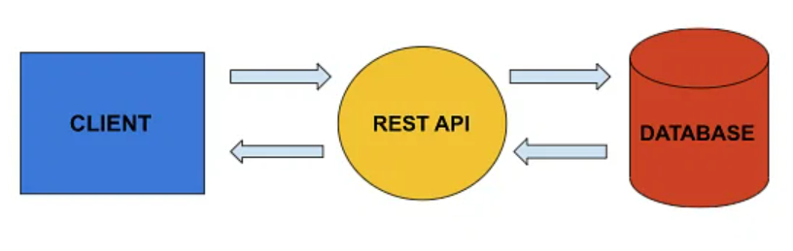
REST

Slide 72
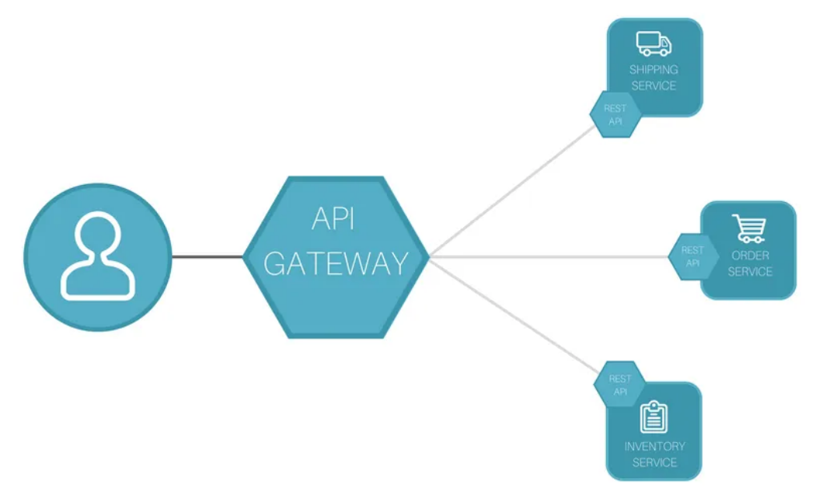
REST

Slide 73
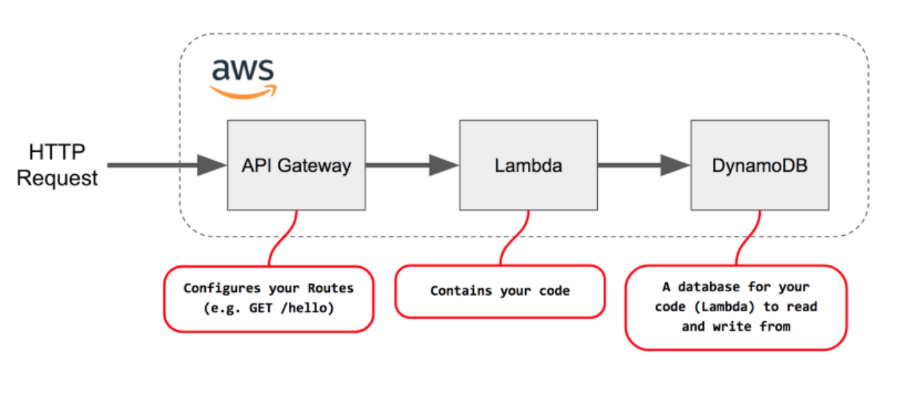
REST

Slide 74
Http request types :
HTTP Requests are simply messages that are sent by the client to do some tasks on the server
GET - Get command is used to request data from the server, but mainly this method is used to read data
PATCH - This command is used to update, change or replace the data
POST - The post method is used to create new or to edit already existing data
Delete - This delete command is used to delete the data completely from the server

Slide 75
Example :-
const express = require('express');
const app = express();
const PORT = process.env.PORT || 3000;
app.use(express.json());
// Define a sample collection of books
const books = [
{ id: 1, title: 'Book 1' },
{ id: 2, title: 'Book 2' },
// ... add more books here
];
// Define routes for the API
app.get('/api/books', (req, res) => {
res.json(books);
});
app.get('/api/books/:id', (req, res) => {
const id = parseInt(req.params.id);
const book = books.find(book => book.id === id);
if (book) {
res.json(book);
} else {
res.status(404).json({ message: 'Book not found' });
}
});
// Start the server
app.listen(PORT, () => {
console.log(`Server is running on port ${PORT}`);
});

Slide 76
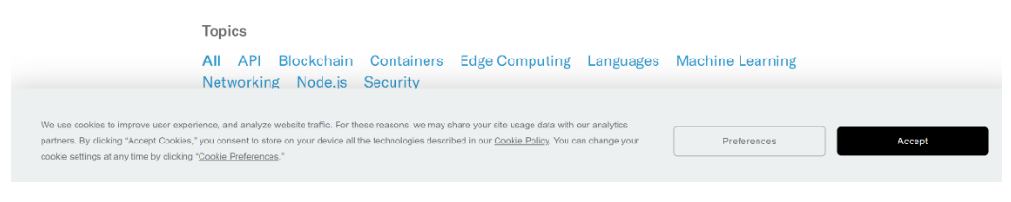
What are cookies?
A cookie is usually a tiny text file stored in your web browser. A cookie was initially used to store information about the websites that you visit. But with the advances in technology, a cookie can track your web activities and retrieve your content preferences.

Slide 77
Different types of cookies :
Session cookies - store user’s information for a short period. When the current session ends, that session cookie is deleted from the user’s computer.
Persistent cookies - a persistent cookie lacks expiration date. It is saved as long as the webserver administrator sets it.
Secure cookies - are used by encrypted websites to offer protection from any possible threats from a hacker.
Third-party cookies - are used by websites that show ads on their pages or track website traffic. They grant access to external parties to decide the types of ads to show depending on the user’s previous preferences.

Slide 78
Install and use cookie
const express = require('express');
const cookieParser = require('cookie-parser');
const app = express();
app.use(cookieParser());

Slide 79
Setting cookies
app.get('/set-cookie', (req, res) => {
res.cookie('username', 'john_doe', { maxAge: 900000, httpOnly: true });
res.send('Cookie has been set');
});

Slide 80
Reading cookies
app.get('/get-cookie', (req, res) => {
const username = req.cookies.username;
res.send(`Username from cookie: ${username}`);
});

Slide 81
Clearing cookies
app.get('/clear-cookie', (req, res) => {
res.clearCookie('username');
res.send('Cookie has been cleared');
});

Slide 82
What is a Session ?
In Express.js, a session refers to a mechanism for maintaining stateful information about a user's interactions with a web application across multiple requests and responses. HTTP, which is the underlying protocol of the web, is stateless, meaning that each request from a client to a server is treated as an independent transaction without any memory of previous requests. Sessions allow you to overcome this limitation and create a sense of continuity for users as they navigate through your application.

Slide 83
Session
Express.js does not have built-in support for sessions by default, but there are popular middleware packages, such as express-session :
Here's how sessions work in Express using the express-session middleware:
Session Initialization: To use sessions, you need to include the express-session middleware in your Express application. You typically configure this middleware with options such as the secret key for encrypting session data, the session store (where session data is stored), and other settings.

Slide 84
Session
Session Creation: When a user makes a request to your Express application, the middleware generates a unique session identifier (often stored in a cookie) and sets it in the user's browser. This identifier is used to link subsequent requests from the same user to the same session.
Session Data: You can store data associated with a user's session on the server. This data can include information like user authentication status, shopping cart contents, user preferences, etc.
Subsequent Requests: As the user interacts with your application, the session identifier is automatically included in each request via the cookie. The server uses this identifier to retrieve the associated session data from the session store.

Slide 85
Session
Session Updates: You can modify session data throughout the user's interaction with the application. For example, if a user logs in, you can set a flag in the session data to indicate their authentication status.
Session Expiry: Sessions typically have an expiration time. If the user is inactive for a specified period, the session data may be discarded. This is useful for managing server resources and security.
Session Termination: When a user logs out or the session expires, you can destroy the session, removing all associated session data.

Slide 86
Example :-
const express = require('express');
const session = require('express-session');
const app = express();
const port = 3000;
// Configure session middleware
app.use(session({
secret: 'mysecretkey', // Change this to a strong secret key
resave: false,
saveUninitialized: true
}));
// Route to set session data
app.get('/set-session', (req, res) => {
req.session.username = 'john_doe'; // Set a session variable
res.send('Session data set!');
});
// Route to retrieve session data
app.get('/get-session', (req, res) => {
const username = req.session.username || 'Guest'; // Get the session variable or default to 'Guest'
res.send(`Hello, ${username}!`);
});
// Route to clear session data
app.get('/clear-session', (req, res) => {
req.session.destroy(err => {
if (err) {
console.error('Error destroying session:', err);
} else {
res.send('Session cleared!');
}
});
});
app.listen(port, () => {
console.log(`Server is running on port ${port}`);
});

Slide 87
Difference between session and cookies
A cookie is a key-value pair that is stored in the browser. The browser attaches cookies to every HTTP request that is sent to the server.
In a cookie, you can’t store a lot of data. A cookie cannot store any sort of user credentials or secret information. If we did that, a hacker could easily get hold of that information and steal personal data for malicious activities.
On the other hand, the session data is stored on the server-side, i.e., a database or a session store. Hence, it can accommodate larger amounts of data. To access data from the server-side, a session is authenticated with a secret key or a session id that we get from the cookie on every request

Slide 88
Thank You

